Slide 1




Starter:
Join dots on each grid below to make the named quadrilateral.
You must use the side given, you can't shorten or extend it.

Slide 2
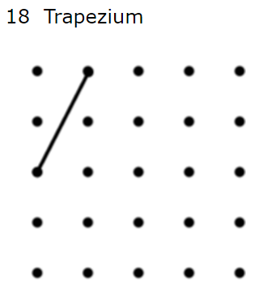
If there is more than one possible shape that you can draw… try to find the one with the largest area.
Example:
The new, red, trapezium has area 1 square unit greater than the original shape.

Slide 3
Check each shape – have you managed to find the maximum area?
1) 6 rectangle
2) 8 square
3) 4 rectangle
4) 12 isosceles trapezium
5) 19 parallelogram
6) 8 kite
7) 6 parallelogram
8) 5 square
9) 12 kite
10) 4 rhombus
11) 3 parallelogram
12) 6 kite
13) 6 arrowhead
14) 8 kite
15) 8 rhombus
16) 3 rhombus
17) 4 arrowhead
18) 9 trapezium
19) 8 parallelogram
20) 8 isosceles trapezium
21) 3 kite
22) 4 arrowhead
23) 9 kite
24) 9 trapezium
Why are some of the areas in red?

Slide 4


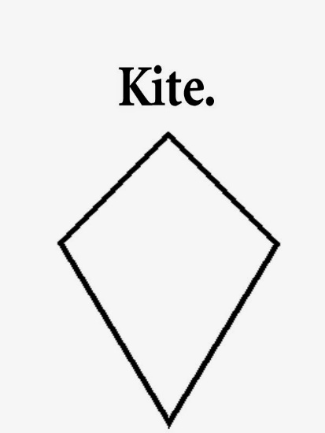

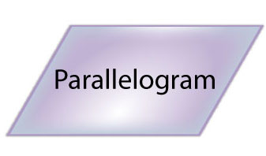
How do you define a rectangle?
How do you define a rhombus?
How do you define a kite?
How do you define a parallelogram?

Slide 5

rectangle rhombus kite parallelogram
Can you use this to help you increase the area of any of the shapes you have drawn?
Which group do I belong in?
Are there any other shapes that could belong in more than one group?

Slide 6
5) 19 parallelogram (10 if you do allow squares)
10) 4 rhombus (5 if you do allow squares)
11) 3 parallelogram (6 if you do allow rectangles)
http://nrich.maths.org/11234/clue

